Slide 1

Introduction to Data Science and ML with Python
Presentation by Jonathan Waring, Technology and Workshop leader

Slide 2
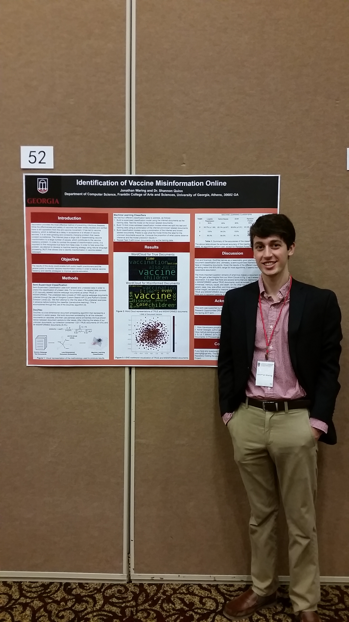
About the Presenter
4th Year Computer Science Major at University of Georgia Honors Program
Minoring in Public Health
Certificate in Applied Data Science
Plans to attend Graduate School for Health Informatics/Data Science and to one day work at the CDC
My academic interests include the intersection of data science and public health, modeling infectious disease spread, natural language processing, and science communication
Feel free to connect with me on LinkedIn

Slide 3
Data Dawgs
Data Dawgs is an Informatics (an artificial intelligence discipline) organization at the UGA College of Engineering
We are mainly focused on Data Science with minor emphasis in Machine Learning and Deep Learning
What we do? Coding workshops, networking events, develop data science skills, participate in data science competitions
Learn more at https://datadawgs.github.io/

Slide 4
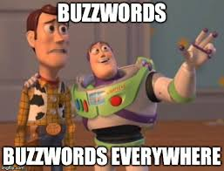
Buzzword Ambiguity
The terms informatics, data analytics, machine learning, data mining, and data science are often used interchangeably without many people really knowing what they mean
Let’s start by trying to establish the differences between the fields

Slide 5
Informatics
The term “informatics” broadly describes the study and practice of creating, storing, finding, manipulating and sharing information.
The field considers the interaction between humans and information alongside the construction of interfaces, organizations, technologies, and systems.
The term was coined as a combination of "information" and "automatic" to describe the science of automating information interactions

Slide 6
Data Analytics
Data analytics refers to qualitative and quantitative techniques and processes used to enhance productivity and business gain.
Data analytics is the process of examining data sets in order to draw conclusions about the information they contain, increasingly with the aid of specialized systems and software
This term is perhaps the most ambiguous one of them all

Slide 7
Machine Learning
Machine learning is a field of computer science that gives computers the ability to learn without being explicitly programmed
Machine learning is a broad term to refer to methods used to devise complex models and algorithms that lend themselves to pattern recognition
Machine learning can be further classified into different categories depending on the nature of the data being inputted to the system OR by considering the desired output of the system → we’ll look at these later

Slide 8
Data Mining
Finding patterns in data that provide insight or enable fast and accurate decision making
The overall goal of the data mining process is to extract information from a data set and transform it into an understandable structure for further use.
The term is bit of a misnomer, because the goal is the extraction of patterns and knowledge from large amounts of data, not the extraction (mining) of data itself

Slide 9
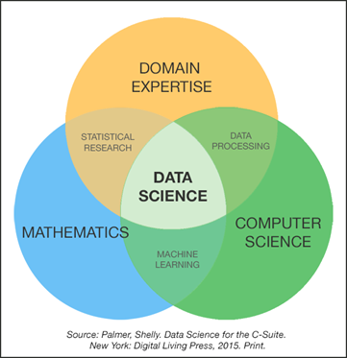
Data Science
Data science is often described as the intersection of mathematics/statistics, computer science, and domain expertise
Data Science really encompasses the entire problem stack:
Problem definition (domain expertise)
Data collection & cleaning (informatics)
Exploration (data analytics)
Modeling (machine learning)
Interpretation & insights (data mining)

Slide 10
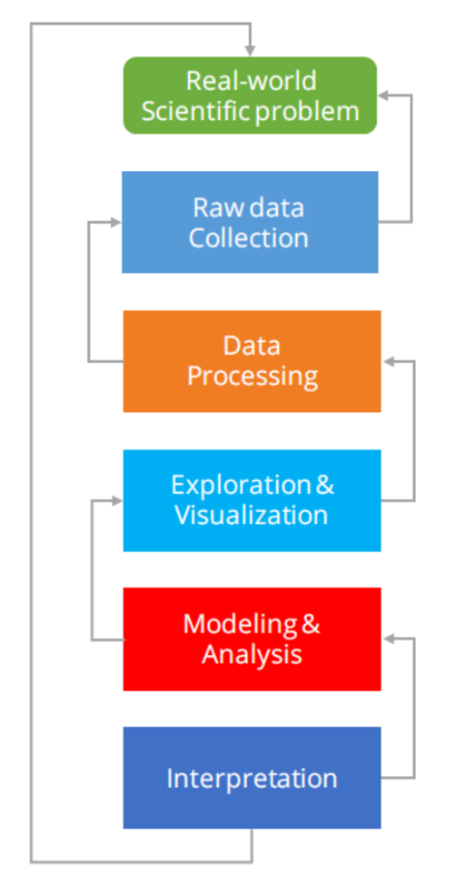
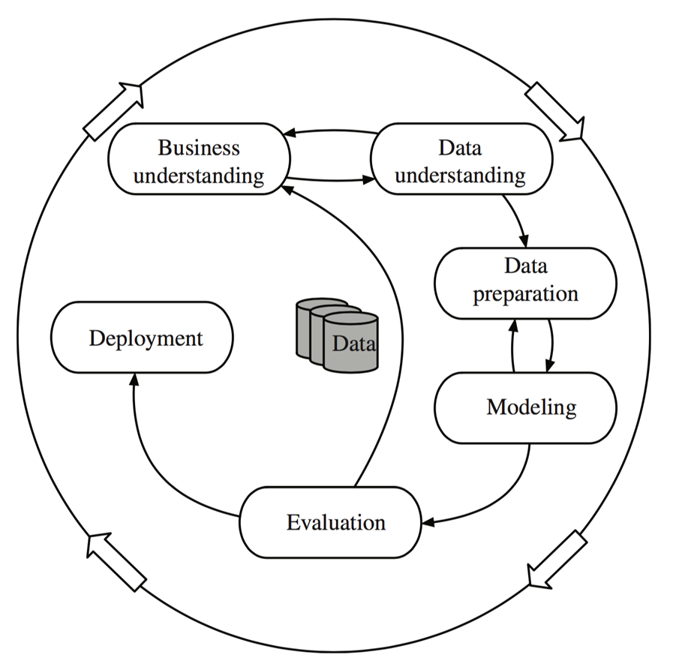
Data Science Processes

Slide 11
From data to Information
Society produces huge amounts of data
Sources: business, science, medicine, economics, geography, environment, sports, …
This data is a potentially valuable resource
Raw data is useless: need techniques to automatically extract information from it
Data: recorded facts
Information: patterns underlying the data
We are concerned with machine learning techniques for automatically finding patterns in data
Patterns that are found may be represented as structural descriptions or as black-box models

Slide 12
What does it mean for machines to “learn”?
Definitions of learning from the dictionary:
To get knowledge of by study, experience, or being taught
To become aware by information or from observation
To commit to memory
To be informed of, ascertain; to receive instruction
The first two definitions are hard to measure, while the last two are trivial
We define learning as:
Things learn when they change behavior in such a way that makes them perform better in the future → quite a few ways to measure this (cost function, accuracy, precision, F1 score, etc.)

Slide 13
Three broad Categories of Machine Learning
As mentioned earlier, machine learning can be broken down into three categories depending on the nature of the input data given to the learner:
Supervised: This means that the computer is presented with example inputs and their desired outputs, given by a "teacher", and the goal is to learn a general rule that maps inputs to outputs
Unsupervised: No labels are given to the learning algorithm, leaving it on its own to find structure in its input
Reinforcement Learning: A computer program interacts with a dynamic environment in which it must perform a certain goal. The program is provided feedback in terms of rewards and punishments as it navigates its problem space.

Slide 14
What Information can we Learn?
It might surprise you, but there are only five questions that data science answers:
Is this A or B?
Is this weird?
How much or How many?
How is this organized?
What should I do next?
Each one of these questions is answered by a separate family of machine learning methods, called algorithms

Slide 15
Is This A or B? → Classification
Determining whether an example is A or B is called a two-way classification problem.
You can extend this question to ask is this A or B or C (or D, etc.), and this is known as multiclass classification.
Classification is a supervised machine learning problem.
Spam filtering is an example of classification, where the inputs are emails and the classes are "spam" and "not spam".

Slide 16
Is This weird? → Anomaly detection
Anomaly detection is the identification of items, events or observations which do not conform to an expected pattern or other items in a dataset
Anomalies are also referred to as outliers, novelties, noise, deviations and exceptions
Anomaly detection may be unsupervised or supervised
If you have a credit card, you’ve already benefited from anomaly detection.
Your credit card company analyzes your purchase patterns, so that they can alert you to possible fraud.

Slide 17
How much or how many? → regression
Regression allows you to make predictions from data by learning the relationship between features of your data and some observed, numeric response
Regression makes numerical predictions for everything from what will the temperature be next Tuesday to stock prices to understanding gene regulatory networks (really any question that asks for a number)
Regression is a supervised machine learning problem
If you have a credit card, you’ve already benefited from anomaly detection.
Your credit card company analyzes your purchase patterns, so that they can alert you to possible fraud.

Slide 18
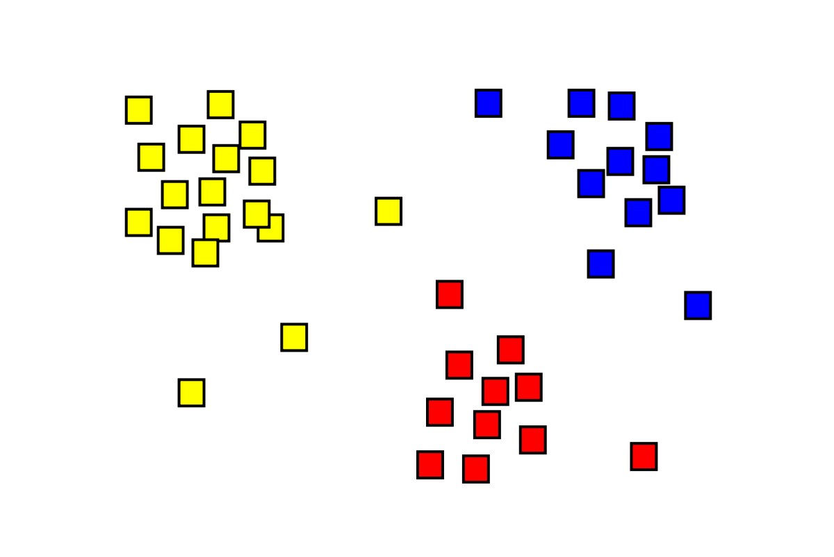
How is this organized? → clustering
Sometimes you want to understand the structure of a dataset, but you don’t have any examples that you already know the outcome for
We therefore know that clustering is an unsupervised machine learning problem
Clustering separates data into natural "clumps," for easier interpretation.
With clustering, there is no one right answer.
By understanding structure, you can better understand - and predict - behaviors and events.
Common example: Which viewers like the same movies?

Slide 19
What should I do now? → reinforcement learning
Reinforcement learning was inspired by how the brains of rats and humans respond to punishment and rewards. These algorithms learn from outcomes, and decide on the next action.
Typically, reinforcement learning is a good fit for automated systems that have to make lots of small decisions without human guidance
Example: If I am a self-driving car, should I brake or accelerate at a yellow light?
Reinforcement learning algorithms gather data as they go, learning from trial and error.

Slide 20
Machine Learning Algorithms
Representation: language for patterns/models, expressive power
Evaluation: scoring methods for deciding what is a good fit of model to data
Beware of overfitting → your model may be “too good” with your training data, but may not generalize well during testing
Search: method for enumerating patterns/models
Optimization techniques → most commonly used optimizer is gradient descent, which iteratively searches for the minimization of some error function (will not go into detail of how this works today)

